Slide 1
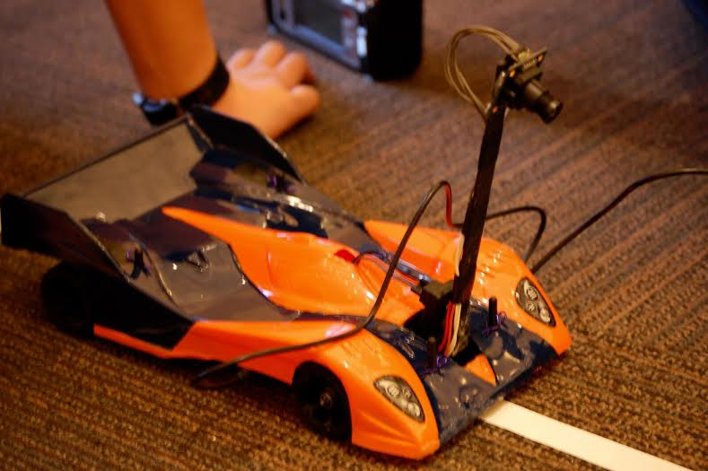
Institute of Navigation(ION) NATCAR Competition Proposal

Slide 2
Past Competition Results Competition Days are 5/13/2017 and 5/21/2017
2016 Natcar
1st UCSD GrandPrIEEE
1st and 4th UC Davis Undergrad Division
2st UC Davis Alumni Division
2015 Natcar
1st and 2nd UCSD
2nd and 4th UC Davis
1st UC Davis Graduate Division
1st and 2nd Fullerton 2nd Annual
2014 Natcar
1st UCSD
1st UC Davis Graduate Division
1st CSUF
2013 Natcar
1st UCSD
1st UC Davis Graduate Division

Slide 3
Cost of Attending
Item | Quantity | Cost/Qty | Itemized Total
UC San Diego Hotel | 2 | $180.00 | $360.00
UC Davis Hotel | 2 | $135.00 | $270.00
Gas San Diego | 15 Gallons | $3.00 | $45.00
Gas UC Davis | 75 Gallons | $3.00 | $225.00
Grand Total |  |  | $900.00

Slide 4
Thank you!

